Slide 1
Finding Ancestors using the Internet
by
Jerry Merritt

Slide 2
Objectives
Pass on a few simple tips and tricks to maximize your chances of finding what you are looking for.
Show search techniques useful in getting the most out of commonly used genealogy research sites.
Offer some actual examples of how volunteers in the WFGL solved longstanding family history problems.

Slide 3
First – a few simple Tips & Tricks
While we normally think of researching family history using genealogy sites…

Slide 4
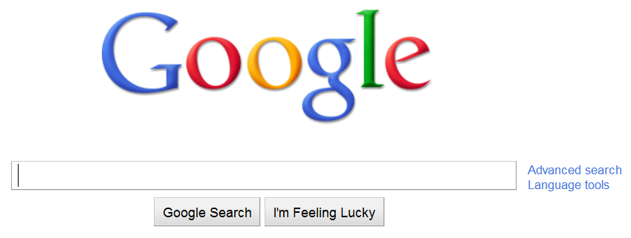
Don’t forget Google

Slide 5
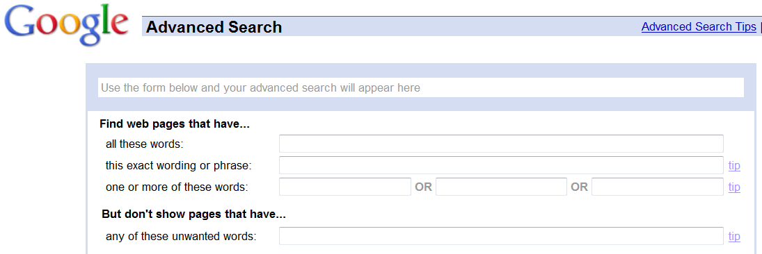
Make the Advanced Page your Homepage

Slide 6
Use First and Last & Last and First
There are many databases totally accessible via Google.
Search for both First and Last & Last and First:
e.g. Isaiah Huston & Huston Isaiah.
Last-First is even more powerful because if Isaiah was listed as Isaiah R. Huston the First-Last search would miss him.

Slide 7
Use all Spellings, Abbreviations and Initials
Robert, Robt, Rob, Rob’t, Robbert, R
William, Wm., Will, Bill, Billy, Billie, W, B, Willie
John, Jno., Jon, Jonny, Jonnie, Johnnie, J
Thomas, Thos., Tom, Tommy Tomas, T

Slide 8
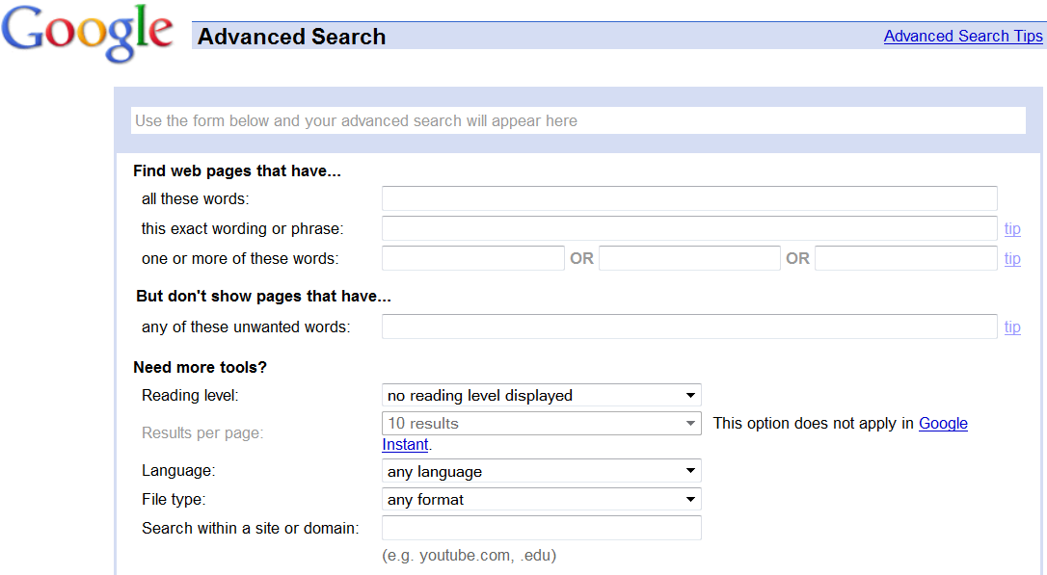
Search an Entire Web Site in one Fell Swoop

Slide 9
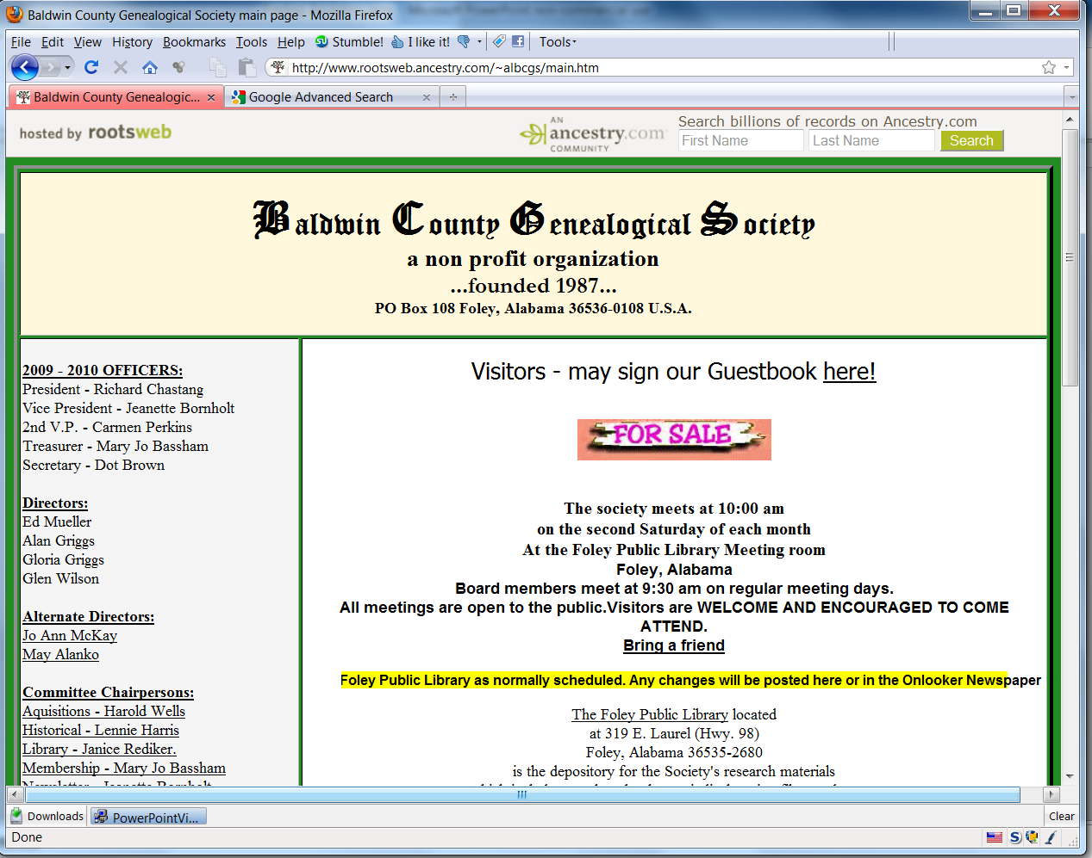

Slide 10
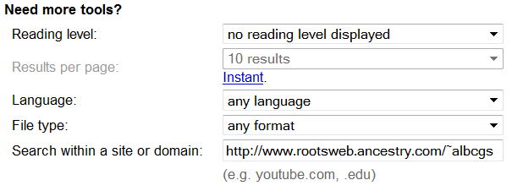
Paste the URL you want to search into

Slide 11
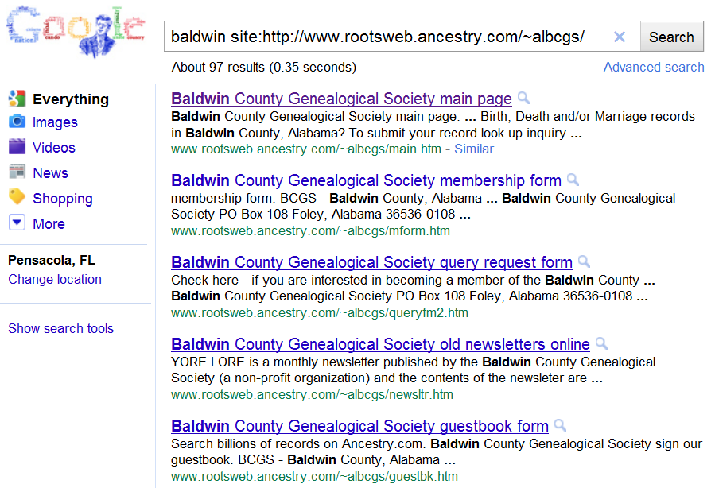

Slide 12
So…
What about some Genealogy Sites to get us started?

Slide 13
Some Great Places to Begin
Heritage Quest
Free access with your library card

Slide 14
Begin by signing in at your Public Library

Slide 15
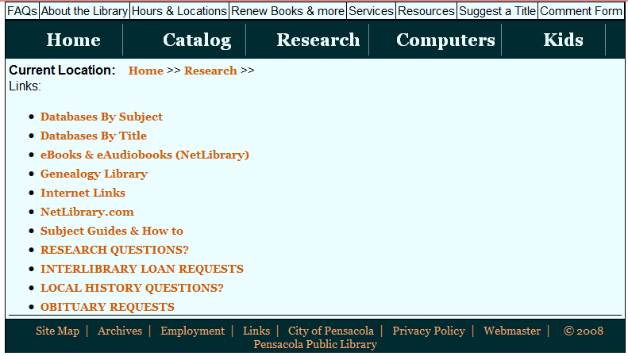
Begin by signing in at your Public Library

Slide 16
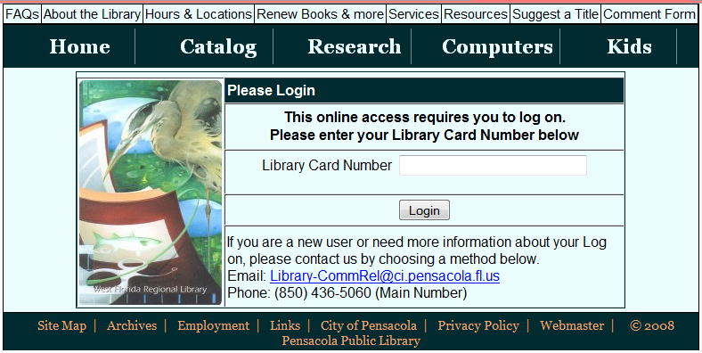
Begin by signing in at your Public Library

Slide 17
Then make this a Favorite
1234 5678 90

Slide 18
Census Search

Slide 20
Search Box Close-up

Slide 21
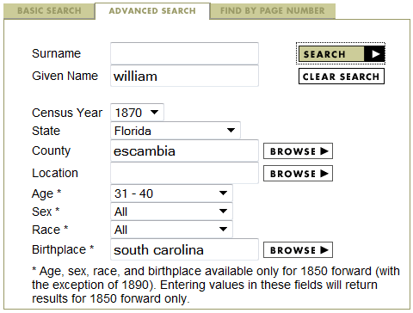
Search by First Name

Slide 24
Finding Wm. Mason

Slide 26
No-name Search for Stefen Awlchenne

Slide 28
Search Alphabetical Surnames for a Close Match

Slide 29
All-Census Search

Slide 30
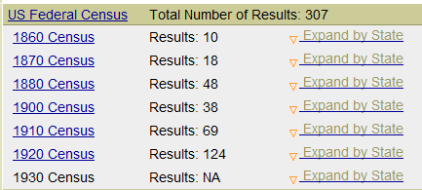

Slide 31
Using the Sort Menu

Slide 32
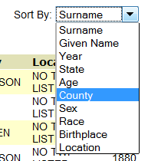
Sorting the List

Slide 34
HQ Limitations
No “smart” name search
If you want Smith and the census has Smyth…
Only head of household listed except in 1880
No 1830, 1840 or 1850 census search
But, you can still Browse those censuses

Slide 37
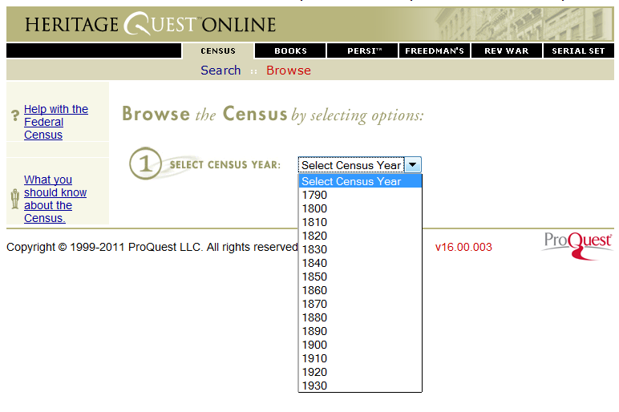

Slide 40
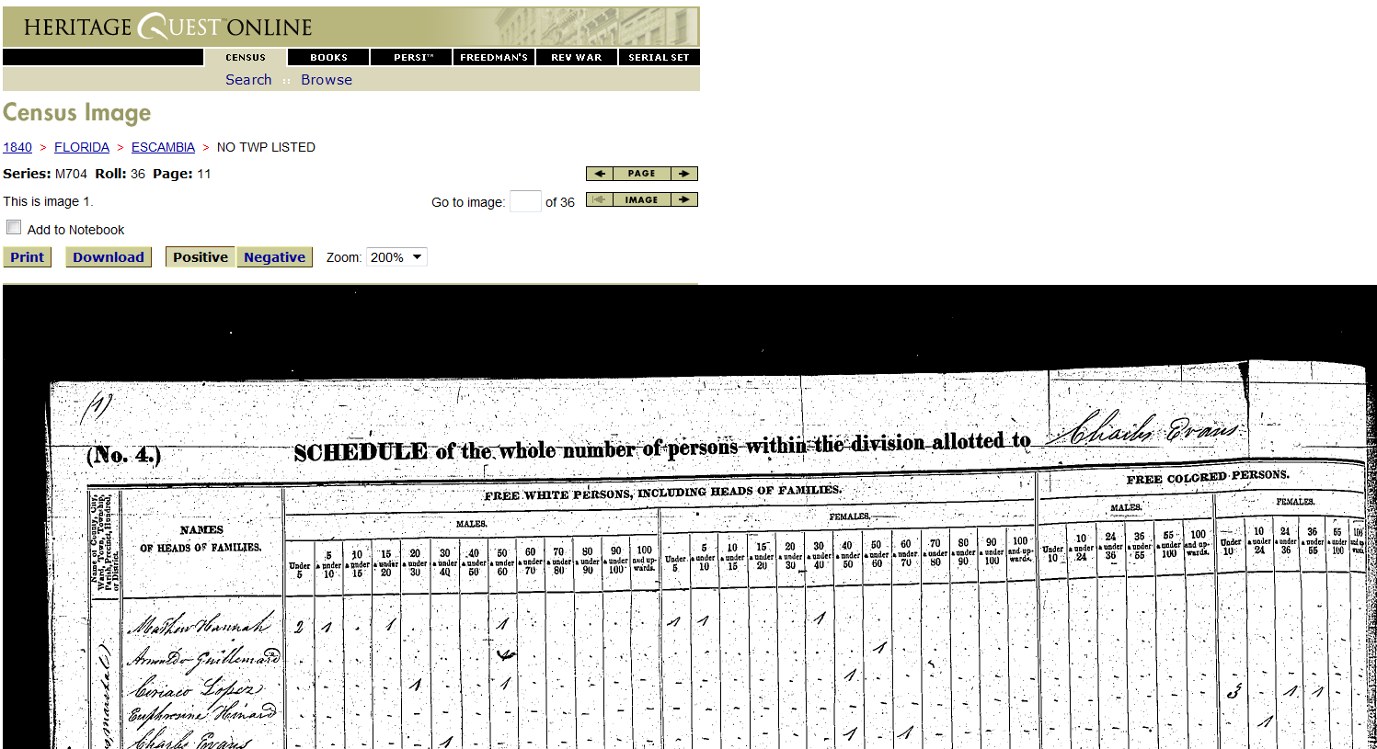
So, now you have your family lineage all wired together except for….

Slide 41
Some More Great Places to Begin
Heritage Quest
Family Search

Slide 48
BTW
The Pilot site and Beta site have the 1850-1920 censuses with all-name indexes.
Just scroll down to United States on the list of offerings where we looked up the Florida Death Certificate.

Slide 49
Some More Great Places to Begin
Heritage Quest
Family Search
Rootsweb’s WorldConnect

Slide 51
WorldConnect Search

Slide 54
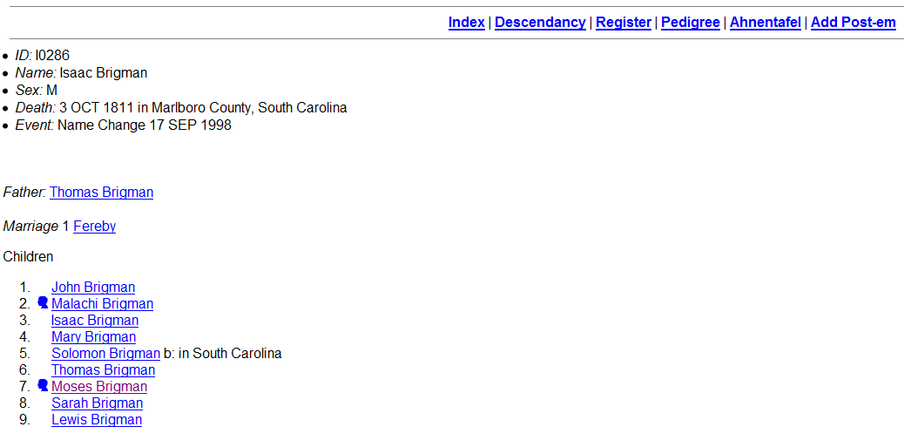

Slide 56
So now you’ve found that missing ancestor
And you’d like to get to know them a little better.

Slide 57
Even More Great Places to Begin
Heritage Quest
Family Search
Rootsweb’s WorldConnect
Ancestry

Slide 58
Tracing oral traditions passed down for 150 years
A story from slave days
Richard Winston’s mother was named Adeline
Adeline was a 16 year old slave when she had Richard
Richard’s father was a slave owner
Richard was very light-complected – almost white
Richard was born in Shelby County, TN about 1860

Slide 59
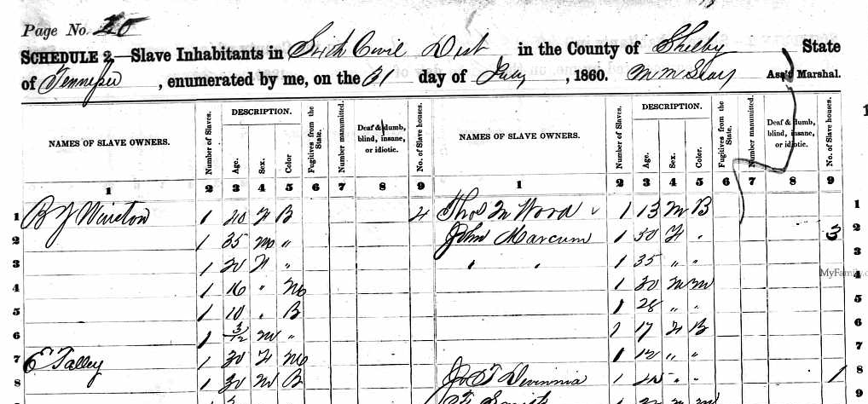
1860 Slave Schedule of Shelby County, TN

Slide 60
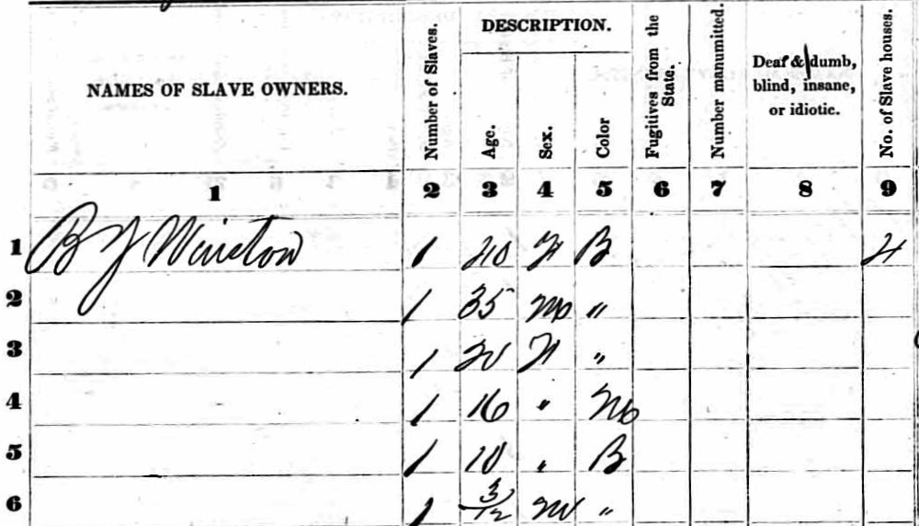
Zooming in on B.Y. Winston

Slide 61
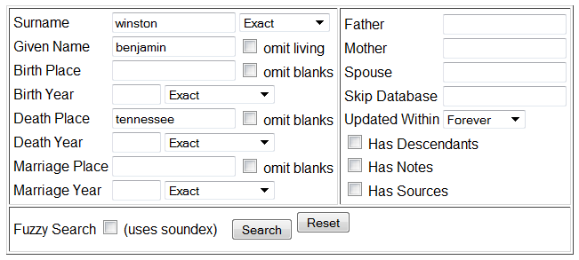
Researching Benj. Winston
Going back to WorldConnect we look for Winstons

Slide 62
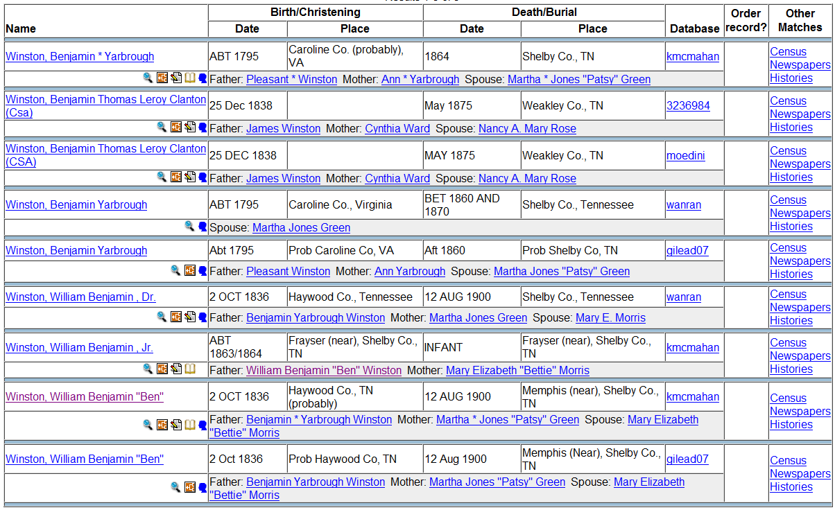

Slide 63
Follow Up
Contact with McMahon led to:
A pedigree back to the 1500s
A photo of Benjamin
A photo of his son – the father of Richard
An ongoing research effort between the families
A chance for more detailed research in Memphis
e.g. Slave records to find Adeline’s mother, marriage records for Adeline, Freedman’s documents, etc.

Slide 64
Follow Up
An ongoing DNA study of the Winston family provides a chance to prove this link conclusively
Finding has made Marilyn a legend at her family reunion
And then from the 1850 slave schedule we have this:

Slide 65
BLM
Bureau of Land Management.
Of course, you can use it to find land records, but…
We are going to use it to find other families allied to Bowmans.

Slide 67
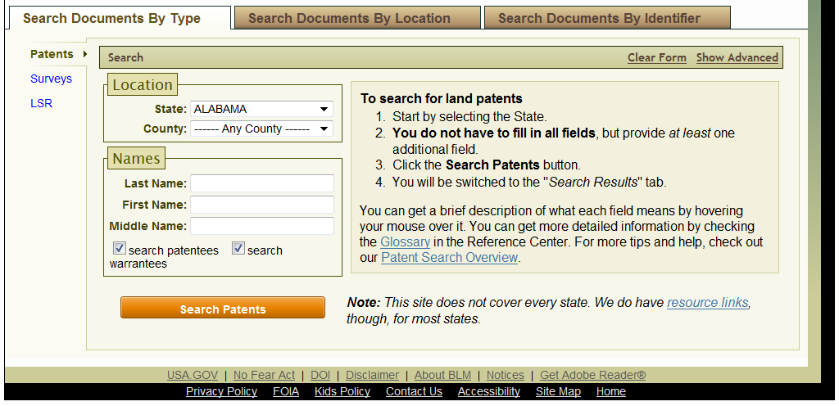
Look for Bowman

Slide 68
Picking up Township, Range and Section

Slide 69
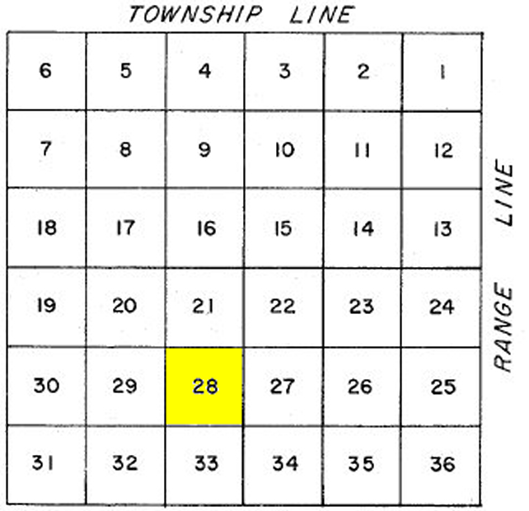
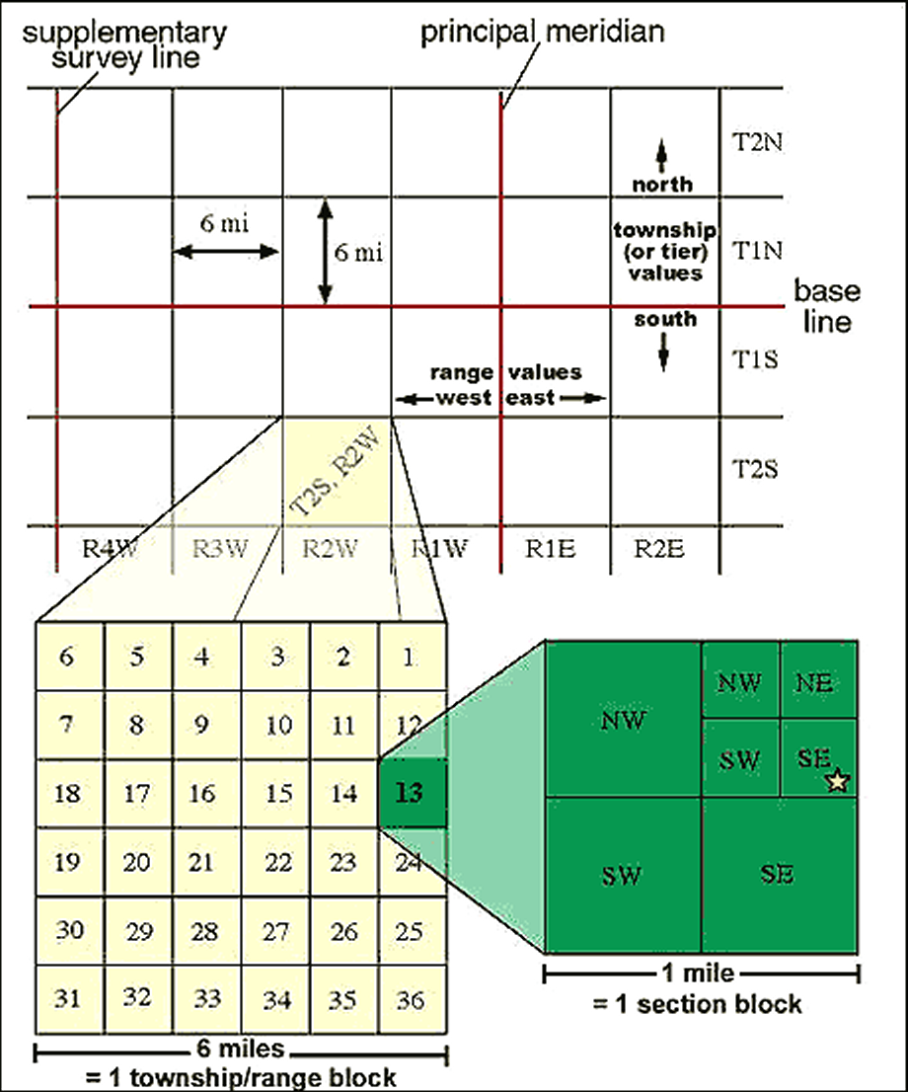

Slide 70
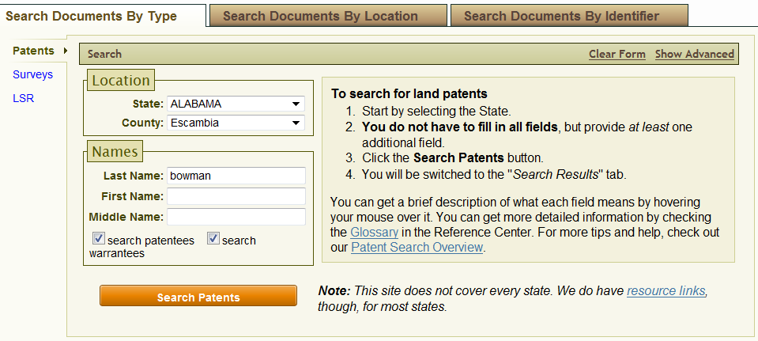
Going to Advanced Search

Slide 71
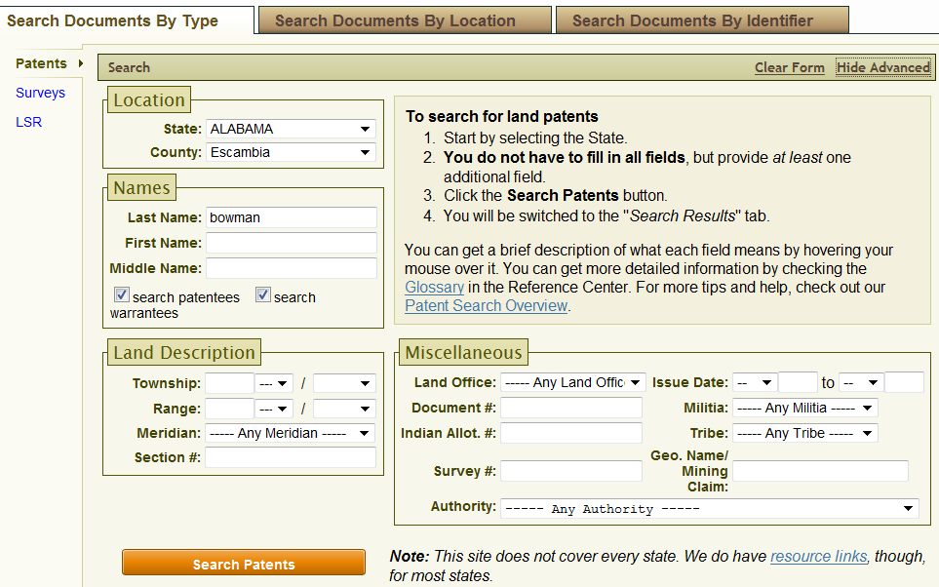
Searching entire Sections

Slide 72
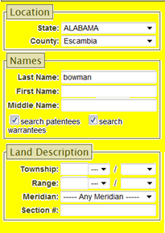
Searching entire Sections

Slide 73
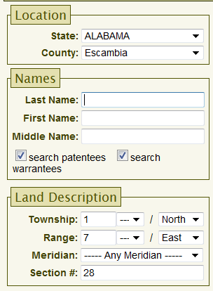
Leave Empty

Slide 74
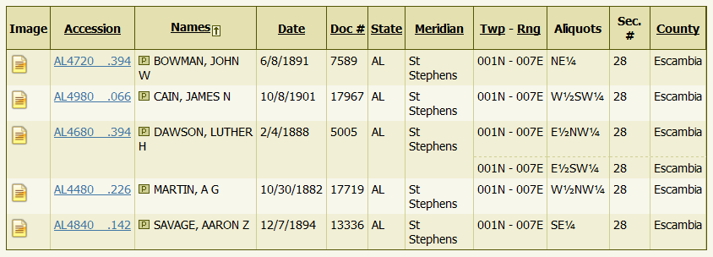
Everyone in Section 28

Slide 75
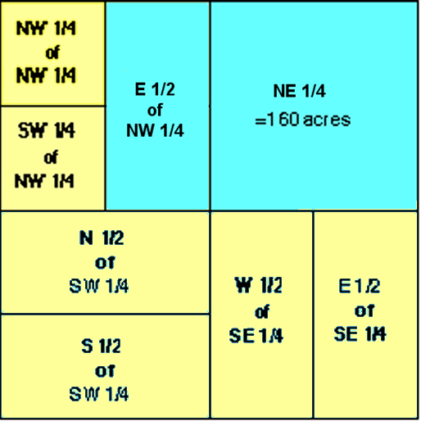
DAWSON
BOWMAN

Slide 76
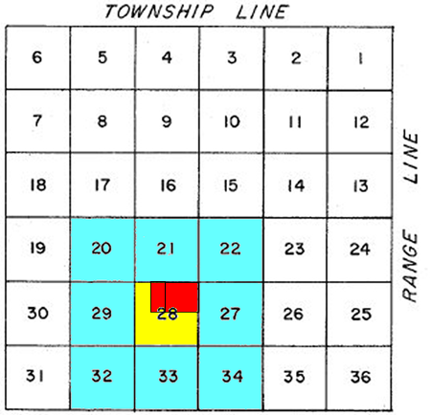
Expand to surrounding sections

Slide 77
Expanding the search to all states
Go to the bottom of the dropdown menu on the state selection box.
Select “–---- Any State -----”

Slide 78
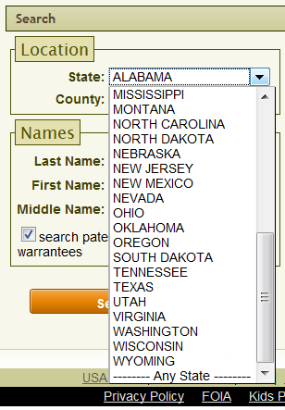

Slide 79
Summary
Search using all potential variations in a name.
Look for Advanced options in web sites.
Use Filtering options to compensate for searches that aren’t producing using a name only.
Don’t depend on one site, like Ancestry, for all data.
Visit as many different sites as possible.
Contact the people who have posted applicable info.
Attend WFGS to learn of new sites as they come on line.
Never give up.

Slide 80
A Final Example from The Genealogy Library
First Name – Leila
Last Name – Perhaps Beale
Status – thought to have been previously married
Former Married or Maiden Name – Unknown
Census Data – only found in one census
Present Husband - Edward Aymard
Other Data – None
Years Spent Searching – Many, many.

Slide 81
There was obviously no point in using the usual databases in this search.
After trying a few other obscure sources….

Slide 82
Some Not So Well-Known Places
Library of Congress – Chronicling America

Slide 90
Thus proving Lee Scott’s Law
It’s written down somewhere.
You just have to find it.

Slide 91
The End

